Slide 1
Information Extraction
USC CSCI 544: Applied Natural Language Processing
Jonathan May -- 梅約納
Nanyun (Violet) Peng – 彭楠赟
October 19 - 24, 2018
Slides from Kai-Wei Chang

Slide 2
Outline
Intro to Information Extraction
Named Entity Recognition
Entity Relation Extraction

Slide 3

T790M is present as a minor clone in NSCLC ,
and may be selected for during therapy .
This mutation has been shown to prevent the activation
of BIM in response to gefitinib
but can be overcome by an irreversible inhibitor of EGFR.
Notes:
To motivate my research, here is a paragraph I took from PubMed, which is an online repository for medical publications, and we want to extract information from it.
If you take 3 sec. to skim through: audience should agree that this passage is somewhat obscure
And let’s see what information you can extract
Lead to the goal of information extraction: extract structured knowledge from unstructured texts.

Slide 4
present
T790M is present as a minor clone in NSCLC ,
and may be selected for during therapy .
This mutation has been shown to prevent the activation
of BIM in response to gefitinib
but can be overcome by an irreversible inhibitor of EGFR.
respond
Notes:
First, you will notice some technical terms (entities) from the texts.
They are termed as entities, which associate with some concrete concepts that are important in forming knowledge. The entities in different domain may care about different entities, such as… Later on in the talk, I will give more details on how we do entity extraction, which involves detecting entity boundaries and predicting entity types. Here I use different color to denote different entity types. Introduce each entity…
There are also relations between the entities. (binary relations, nary relations). I will also explain how to do entity extraction later in this talk.
You can see that entities and relation extractions are two essential elements that constitute knowledge.

Slide 5
U.S. intelligence officials now believe North Korea
is developing the technology to make nuclear
warheads small enough to fit atop the country 's
growing arsenal of missiles potentially putting
Tokyo and U.S. troops based in Japan at risk ,
according to officials who have received the intelligence reports .

Slide 6
U.S. intelligence officials now believe North Korea
is developing the technology to make nuclear
warheads small enough to fit atop the country 's
growing arsenal of missiles potentially putting
Tokyo and U.S. troops based in Japan at risk ,
according to officials who have received the intelligence reports .

Slide 7
U.S. intelligence officials now believe North Korea
is developing the technology to make nuclear
warheads small enough to fit atop the country 's
growing arsenal of missiles potentially putting
Tokyo and U.S. troops based in Japan at risk ,
according to officials who have received the intelligence reports .
PART-WHOLE
ORG-AFF
ART
ART
ORG-AFF
PHYS

Slide 8
Social Media
“Yess! Yess! Its ofﬁcial Nintendo announced today that they Will release the Nintendo 3DS in north America march 27 for $250”
COMPANY | PRODUCT | DATE | PRICE | REGION
PRODUCT RELEASE
Notes:
Next we might classify this post as a PRODUCT RELEASE event.
We might also have a pre-defined idea that product release events involve a company, a product, a date on which the product is released, the price and the geographical region where it is being released.

Slide 9
Social Media
“Yess! Yess! Its ofﬁcial Nintendo announced today that they Will release the Nintendo 3DS in north America march 27 for $250”
COMPANY | PRODUCT | DATE | PRICE | REGION
Nintendo | 3DS | March 27 | $250 | North America
PRODUCT RELEASE
Notes:
And so the information extraction task is to fill in the fields for the event.
So you could imagine many events mentioned on Twitter which fit this general schema.
If we can automatically convert tweets into database rows like this, then we can do SQL-like queries and higher-level data mining and analysis on top of this that wasn’t possible by just directly looking at the text.

Slide 10
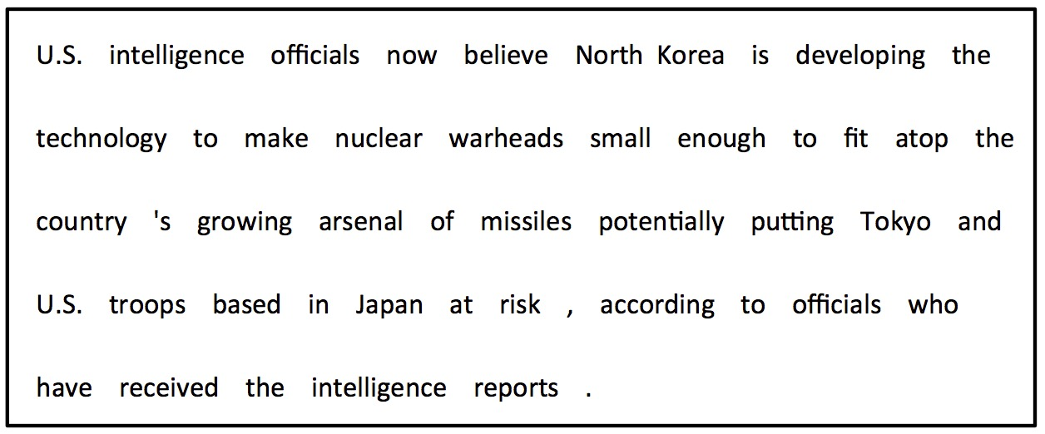

T790M is present as a minor clone in NSCLC ,
and may be selected for during therapy .
This mutation has been shown to prevent the activation
of BIM in response to gefitinib
but can be overcome by an irreversible inhibitor of EGFR.
Structured Knowledge
Entity | Entity | Entity | Relation
T790M | EGFR | gefitinib | Resist
… | … |  | …
Notes:
The goal of information extraction is to extract structured knowledge from unstructured texts, such that both computer and human can easily access to these information through AI agent, search tools, etc.
Make knowledge (more) accessible to computers.
Help humans efficiently process massive amounts of information.

Slide 11
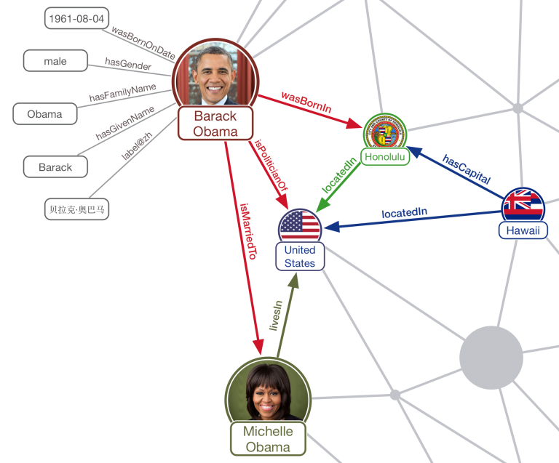
Knowledge Graph

Slide 12








IE
IE
Structured Knowledge
Entity | Entity | Entity | Relation
T790M | EGFR | gefitinib | Resist
Obama | U.S. |  | President_of
… | … |  | …
IE
IE
IE
Notes:
The goal of IE is to extract structured knowledge from unstructured text.
There are many domains that the structured knowledge can be extracted from.

Slide 13

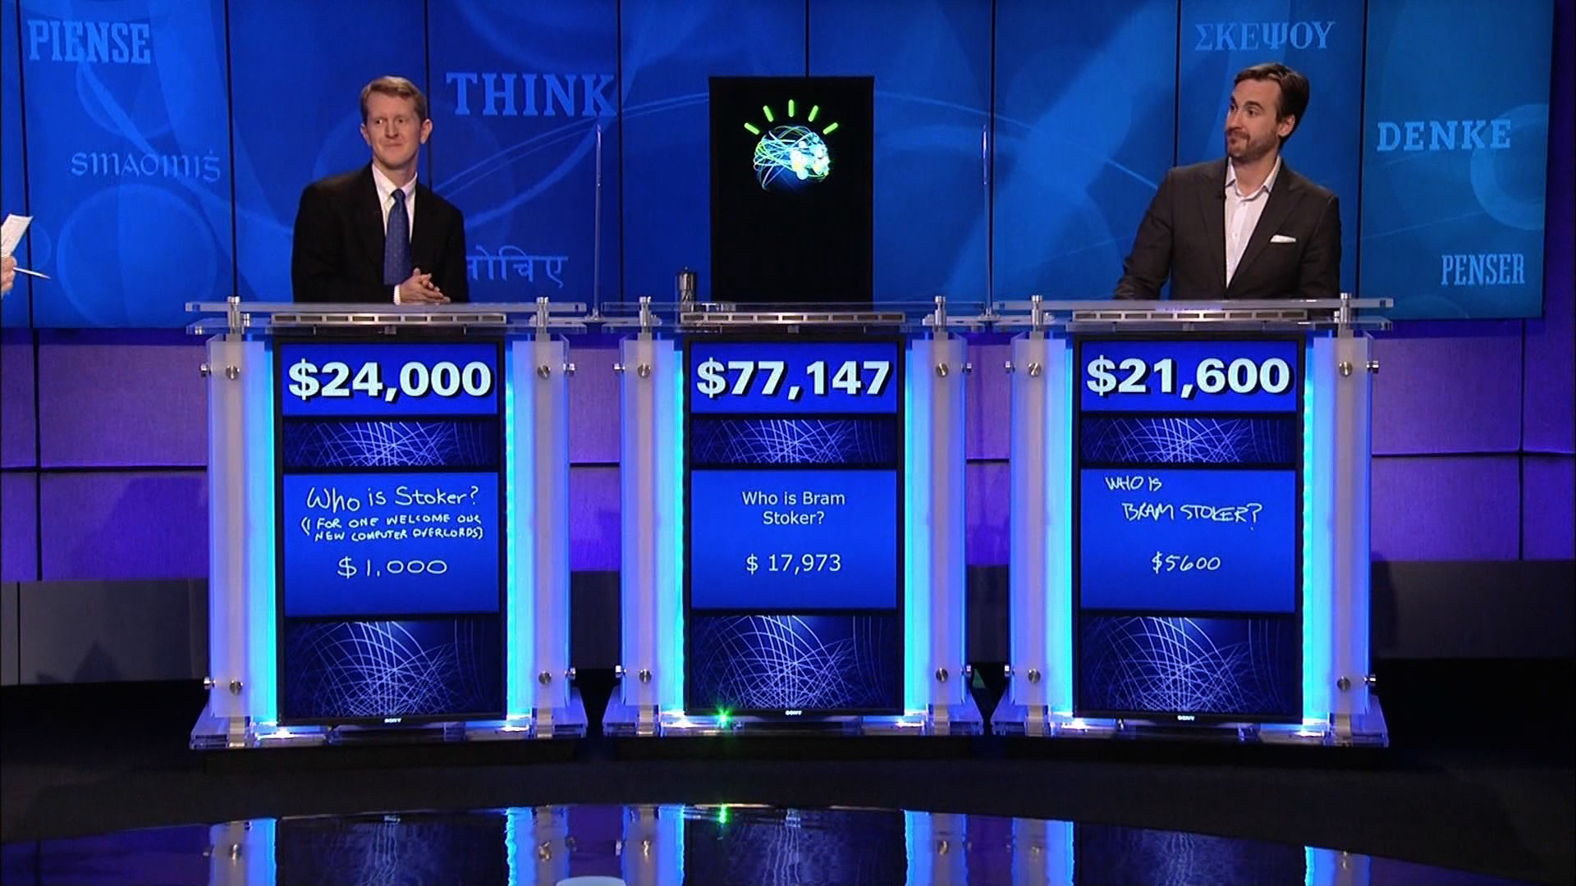

Structured Knowledge
Entity | Entity | Entity | Relation
T790M | EGFR | gefitinib | Resist
Obama | U.S. |  | President_of
Philadelphia | PA. |  | Locate_in
… | … |  | …
Notes:
Structured knowledge is what enables AI systems to detect important event that can help predict the stock price, or even to be able to answer Jeopardy questions at a superhuman level or find new combinations of drugs to fight cancer

Slide 14
Example Applications
Question Answering
Which companies are releasing new smartphones new products in Europe this Spring?
Alert me anytime a new smartphone is announced in the U.S.
Data Analysis
Analyze trends in product releases across different industries
Is there a correlation between price and date of release?

Slide 15
An NLP Perspective: Overview
Real Word Applications
IE Pipeline
Core NLP Pipeline

Slide 16
Parsing
Part-of-speech Tagging
Core NLP Pipeline
Morphology & Phonology Analysis
Tokenization
Raw Texts (input)

Slide 17
Entity Linking
Coreference Resolution
IE Pipeline
Relation Extraction
Event Extraction
Named Entity Recognition
Input Text (with or without Preprocessing throng NLP pipeline)

Slide 18
Knowledge Grpah

Slide 19
Entity Linking
Coreference Resolution
IE Pipeline
Relation Extraction
Event Extraction
Named Entity Recognition
Input Text (with or without Preprocessing)

Slide 20
Outline
Intro to Information Extraction
Named Entity Recognition
Entity Relation Extraction

Slide 21
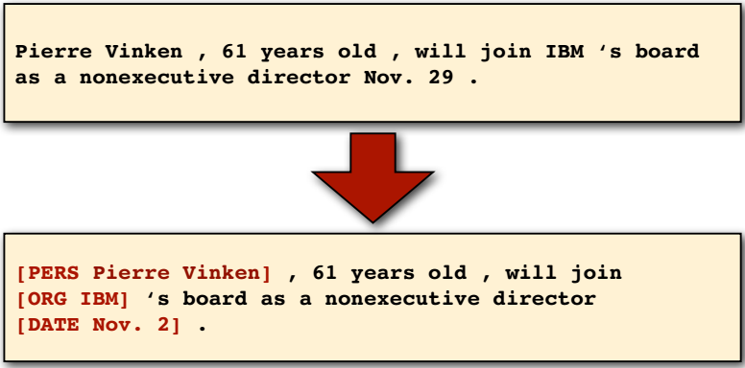
Named Entity Recognition
Task: identify all mentions of named entities (people, organizations, locations, dates) from natural language texts.

Slide 22
Supervised Learning Setting
Assume we have annotated examples
Tag set:
GPE, ORG, PER, O…
NER Tagger
Words
Tags
U.S./GPE intelligence/ORG officials/PER now/O believe/O North/GPE Korea/GPE is/O developing/O the/O technology/O to/O make/O nuclear/O warheads/O small/O.
U.S.
intelligen.
officials
now
believe
North
Korea
GPE
ORG
PER
O
……

Slide 23
Sequence tagging problems
Many problems in NLP can be formulated as sequence tagging problems.
Brainstorm: name other sequential tagging problems

Slide 24
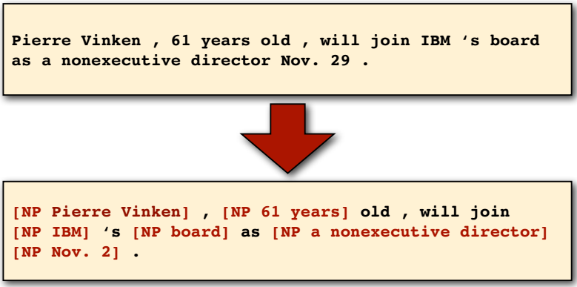
Noun phrase (NP) chunking
Task: identify all non-recursive NP chunks

Slide 25
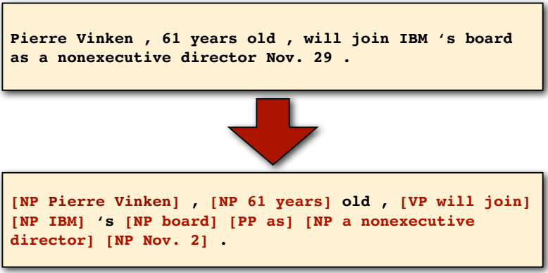
Shallow parsing
Task: identify all non-recursive NP, verb (“VP”) and preposition (“PP”) chunks
Notes:
chunking

Slide 26
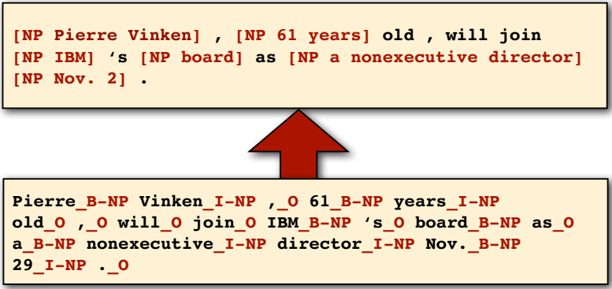
The BIO encoding
Define three new tags
B-NP: beginning of a noun phrase chunk
I-NP: inside of a noun phrase chunk
O: outside of a noun phrase chunk

Slide 27
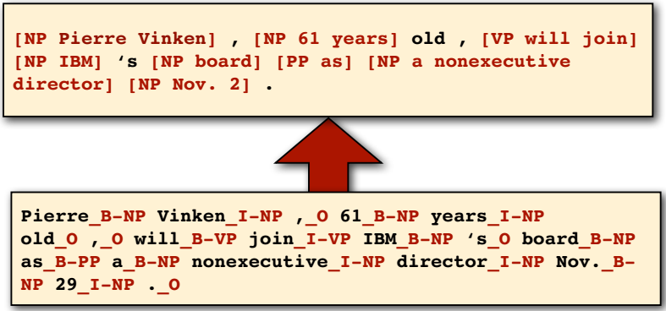
BIO Encoding for Shallow Parsing
Define new tags
B-NP B-VP B-PP: beginning of an “NP”, “VP”, “PP” chunk
I-NP I-VP I-PP: inside of an “NP”, “VP”, “PP” chunk
O: outside of any chunk

Slide 28
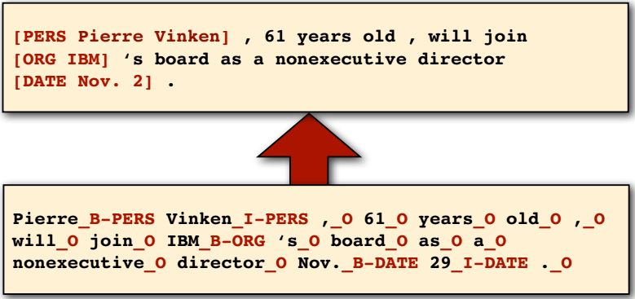
BIO Encoding for NER
Exactly the same problems with different tag set!
Define many new tags
B-PERS, B-DATE,…: beginning of a mention of a person/date...
I-PERS, I-DATE,…: inside of a mention of a person/date...
O: outside of any mention of a named entity

Slide 29
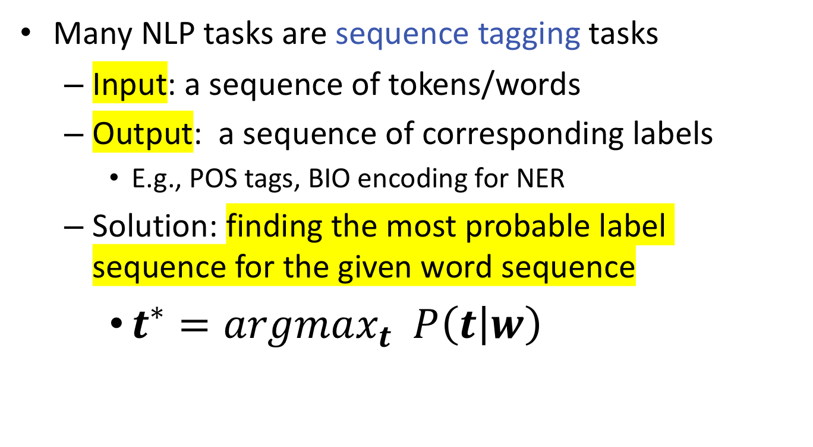
Sequence tagging
Many NLP tasks are sequence tagging tasks
Input: a sequence of tokens/words
Output: a sequence of corresponding labels
E.g., POS tags, BIO encoding for NER
Solution: finding the most probable label sequence for the given word sequence
$t^{∗}=argmax_{t} P\left(t | w\right)$

Slide 30
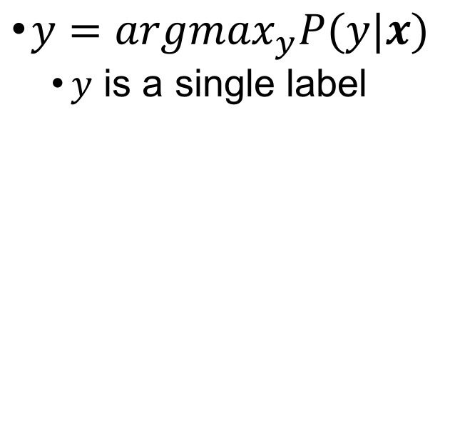
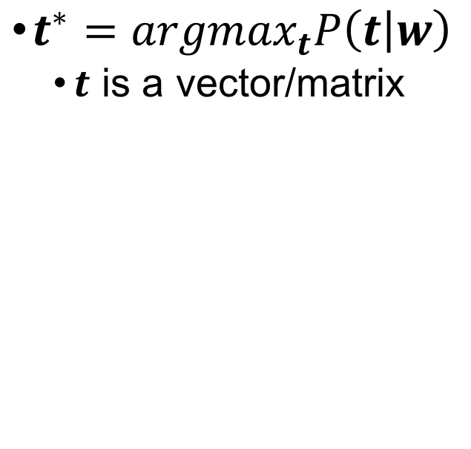
Sequential tagging v.s independent prediction
Sequence labeling
Independent classifiers
$t^{∗}=argmax_{t}P\left(t | w\right)$
$t$ is a vector/matrix
$y=argmax_{y}P(y|x)$
$y$ is a single label
t_{i}
t_{j}
y_{i}
y_{j}
w_{i}
w_{j}
x_{i}
x_{j}

Slide 31
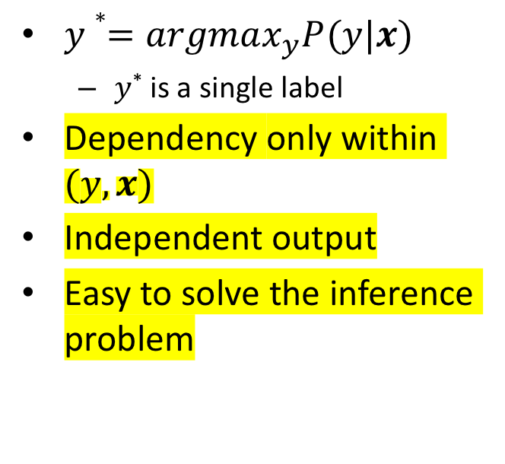
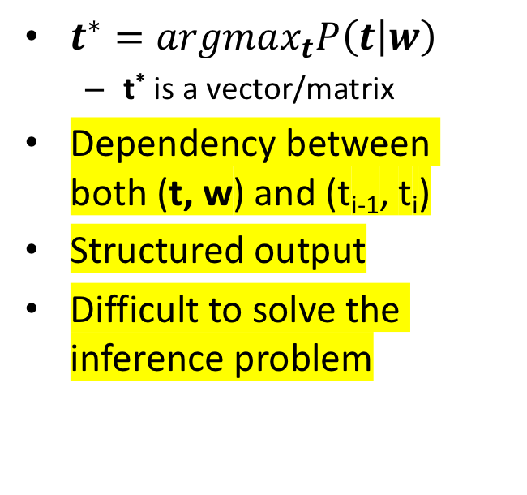
Sequential tagging v.s independent prediction
Sequence labeling
Independent classifiers
$t^{∗}=argmax_{t}P\left(t | w\right)$
t* is a vector/matrix
Dependency between both (t, w) and (t_{i-1}, t_{i})
Structured output
Difficult to solve the inference problem
$y∗=argmax_{y}P(y|x)$
$y$* is a single label
Dependency only within $(y,x)$
Independent output
Easy to solve the inference problem

Slide 32
Jason’s ice cream
Best tag sequence for P(”1,2,1”)?
#cones
0.5
0.4
0.5
C
0.8
C
0.8
C
0.5
0.2
0.2
0.2
0.2
0.5
H
H
H
0.1
0.8
0.2
0.8
0.1
Notes:
ccc

Slide 33
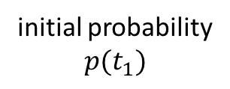
Prediction in generative model
Inference: What is the most likely sequence of tags for the given sequence of words w
What are the latent states that most likely generate the sequence of word w
initial probability
$$p(t_{1})$$

Slide 34
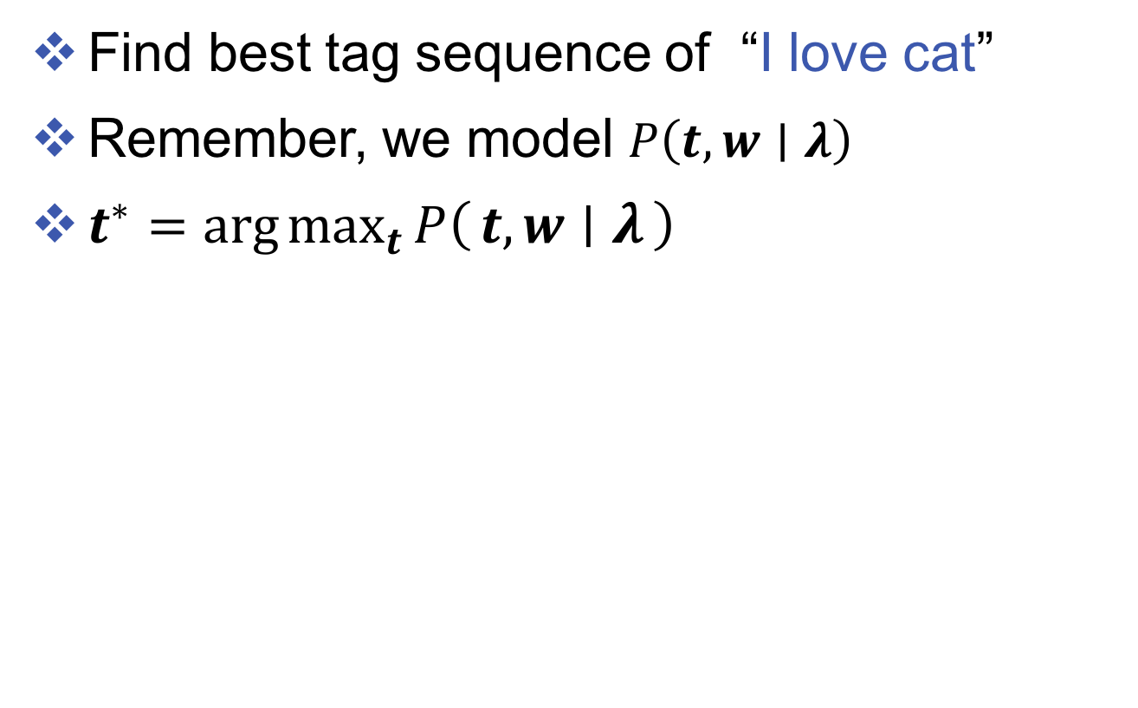
Tagging the input
Find best tag sequence of “I love cat”
Remember, we model $P\left(t,w∣λ\right)$
$t^{∗}=\arg{\max_{t}{P\left(t, w ∣ λ\right)}}$
Find the best one from all possible tag sequences

Slide 35
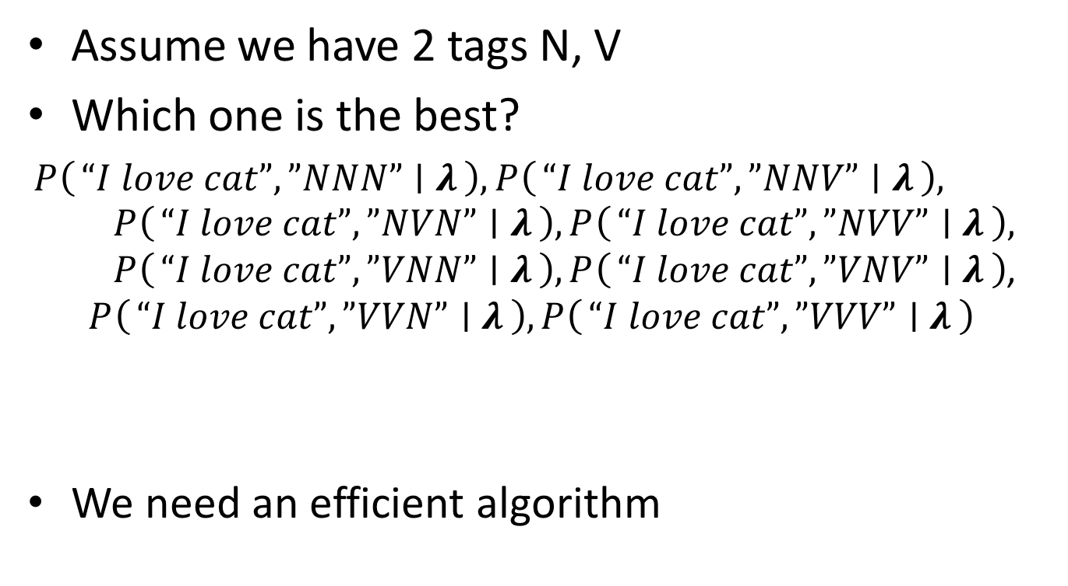
Tagging the input
Assume we have 2 tags N, V
Which one is the best?
$P\left(“I love cat”,”NNN” ∣ λ\right), P\left(“I love cat”,”NNV” ∣ λ\right),$ $P\left(“I love cat”,”NVN” ∣ λ\right), P\left(“I love cat”,”NVV” ∣ λ\right),$ $P\left(“I love cat”,”VNN” ∣ λ\right),P\left(“I love cat”,”VNV” ∣ λ\right)$, $P\left(“I love cat”,”VVN” ∣ λ\right),P\left(“I love cat”,”VVV” ∣ λ\right)$
We need an efficient algorithm
Notes:
What’s the complexity for the problem with k possible tags, and n sequence length?

Slide 36
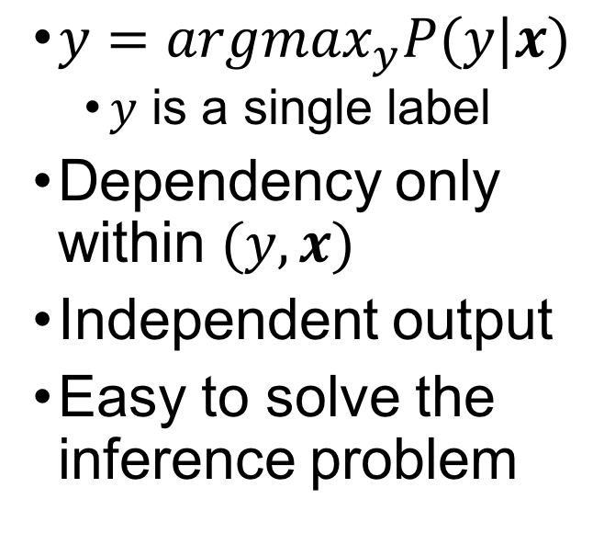
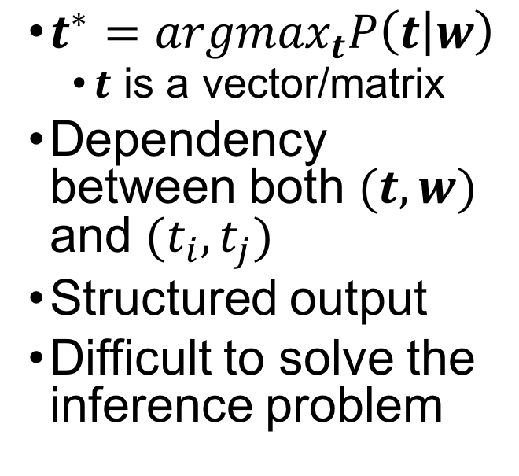
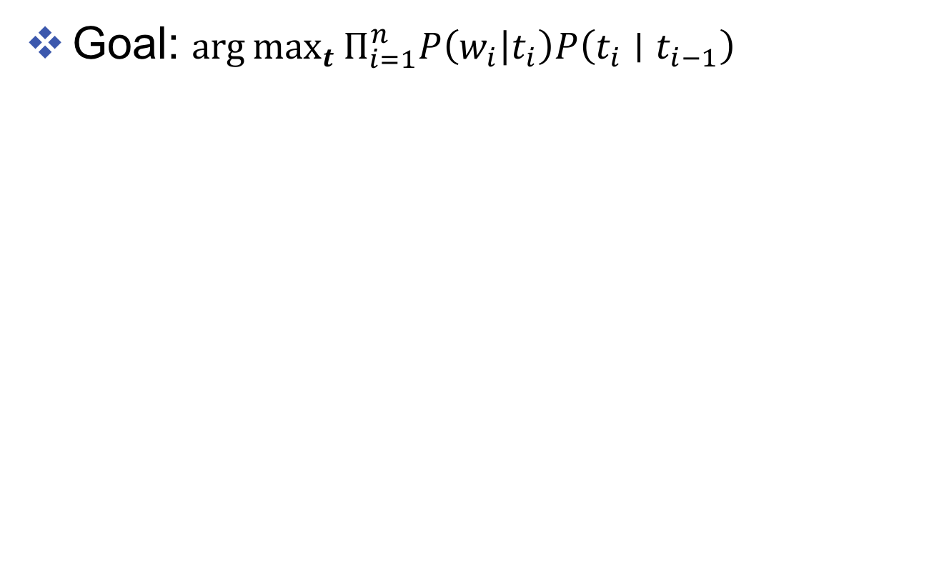
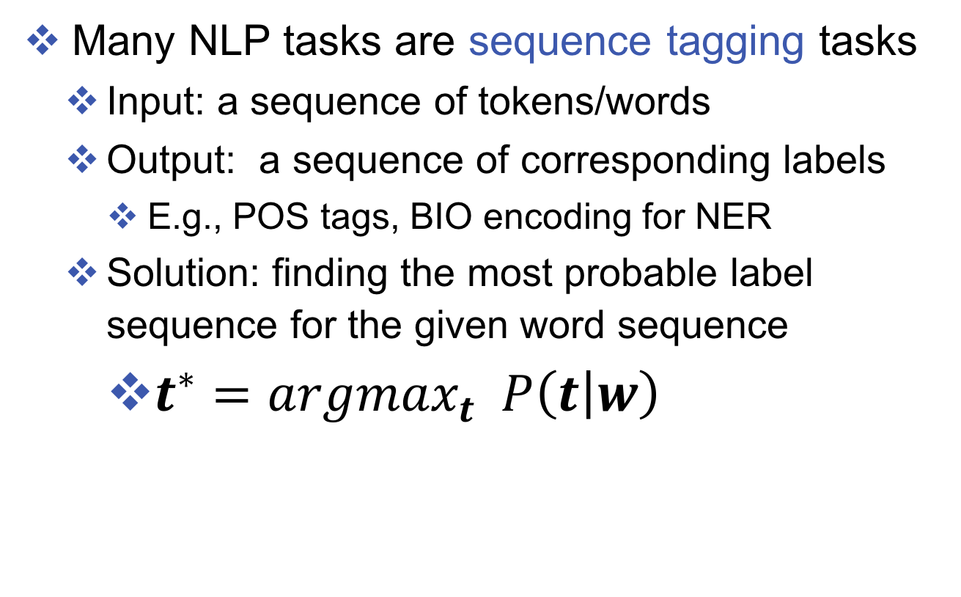
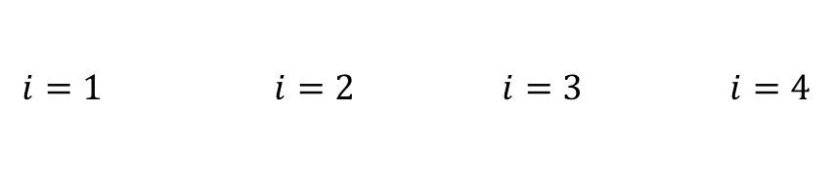
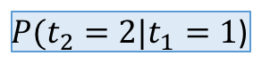
Trellis diagram
Goal: $\arg{\max_{t}{Π_{i=1}^{n}P\left(w_{i} | t_{i}\right)P\left(t_{i}∣t_{i−1}\right)}}$
$P(t_{2}=2|t_{1}=1$)
$P(w_{3}|t_{3}=1$)
$P(t_{3}=1|t_{2}=1$)
$$⋯$$
$$i=1 i=2 i=3 i=4$$

Slide 37

Trellis diagram
Goal: $\arg{\max_{t}{Π_{i=1}^{n}P\left(w_{i} | t_{i}\right)P\left(t_{i}∣t_{i−1}\right)}}$
Find the best path!
N
N
N
N
V
V
V
V
$$⋯$$
A
A
A
A
$$i=1 i=2 i=3 i=4$$

Slide 38
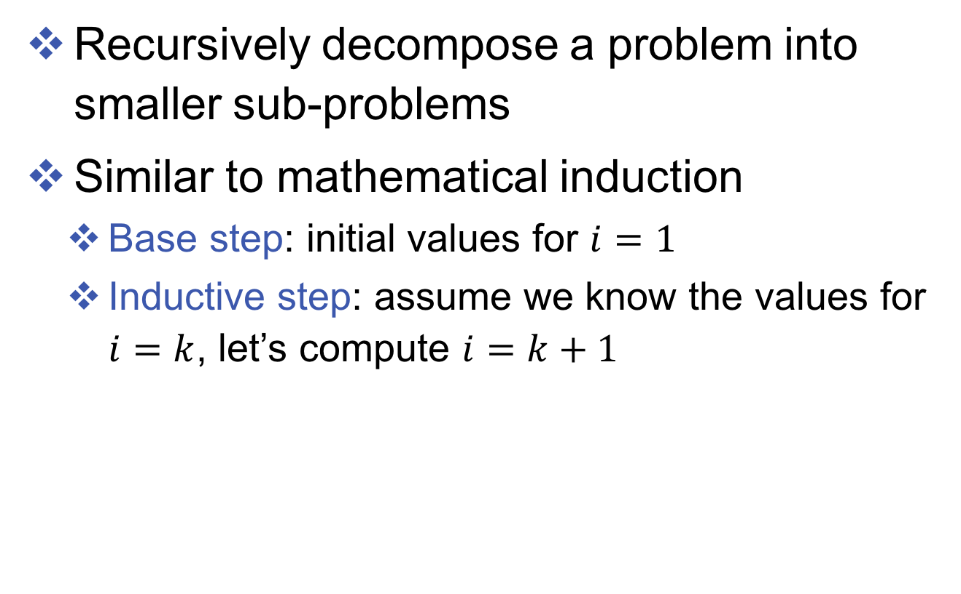
Dynamic programming again!
Recursively decompose a problem into smaller sub-problems
Similar to mathematical induction
Base step: initial values for $i=1$
Inductive step: assume we know the values for $i=k$, let’s compute $i=k+1$

Slide 39
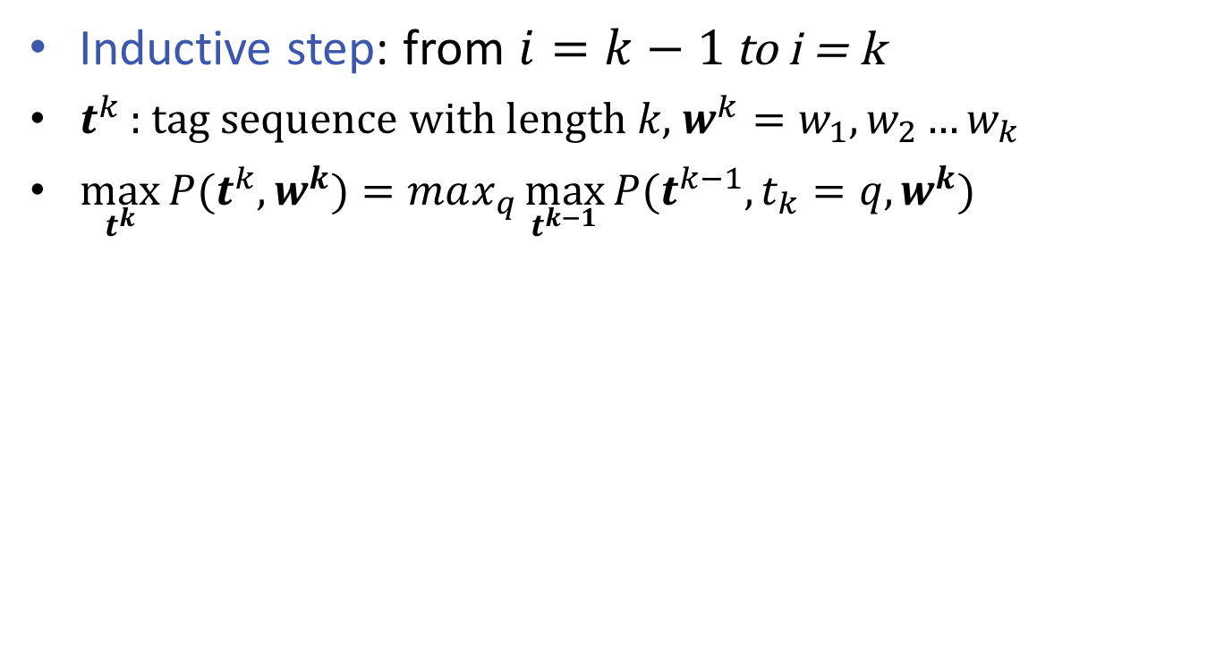
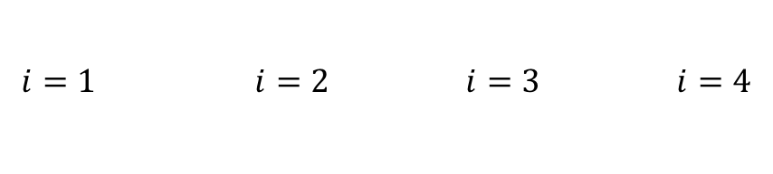
Viterbi algorithm
Inductive step: from $i=k−1$ to i = k
$t^{k}$ : tag sequence with length $k$, $w^{k}=w_{1},w_{2}…w_{k}$
$\max_{t^{k}}{P(t^{k}, w^{k})}=max_{q}{\max_{t^{k−1}}{P(t^{k−1}, t_{k}=q, w^{k})}}$
tag @ i=k
tag sequences
tag sequences
N
N
N
N
V
V
V
V
$$⋯$$
A
A
A
A
$$i=1 i=2 i=3 i=4$$

Slide 40
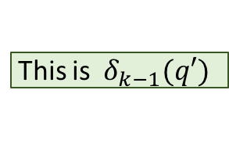
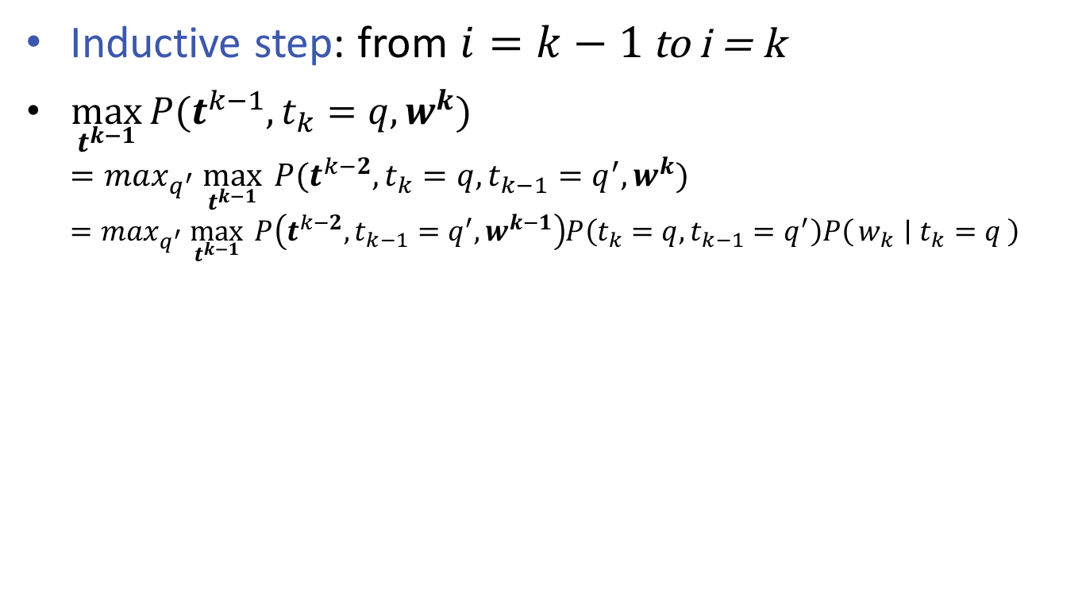
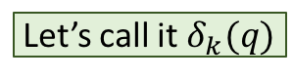

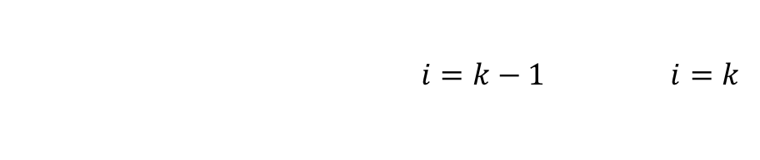
Viterbi algorithm
Let’s call it $δ_{k}(q)$
Inductive step: from $i=k−1$ to i = k
$\max_{t^{k−1}}{P(t^{k−1}, t_{k}=q, w^{k})}$ $=max_{q^{′}} \max_{t^{k−1}}{ P(t^{k−2}, t_{k}=q, t_{k−1}=q^{′}, w^{k})}$ $=max_{q^{′}} \max_{t^{k−1}}{ P\left(t^{k−2}, t_{k−1}=q^{′}, w^{k−1}\right)P\left(t_{k}=q, t_{k−1}=q^{′}\right)P\left(w_{k} ∣ t_{k}=q\right)}$
This is $δ_{k−1}(q′)$
N
N
N
N
V
V
V
V
$$⋯$$
A
A
A
A
$i=k−1 i=k$

Slide 41
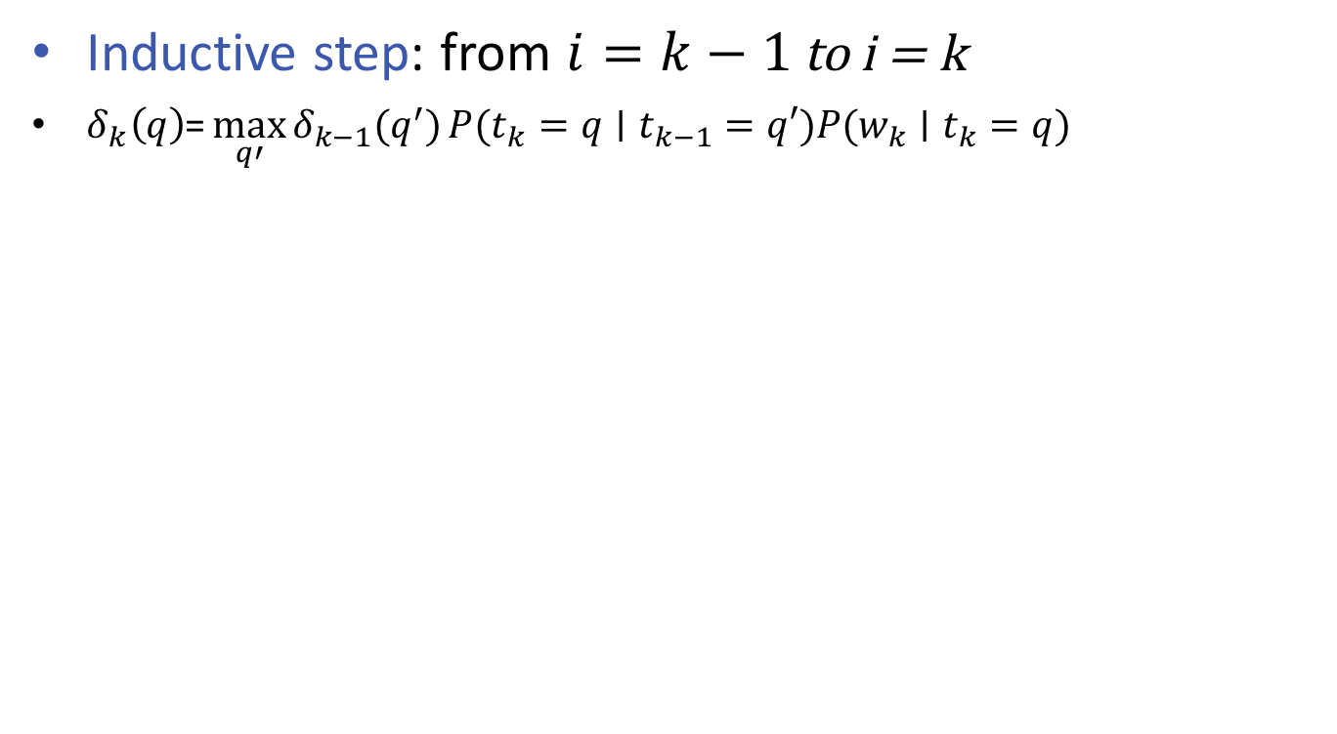
Viterbi algorithm
Inductive step: from $i=k−1$ to i = k
$δ_{k}\left(q\right)\text{=}\max_{q′}{δ_{k−1}(q^{′})}P({t_{k}=q∣t}_{k−1}=q′)P({w_{k}∣t}_{k}=q)$
N
N
N
N
V
V
V
V
$$⋯$$
A
A
A
A
$i=k−1 i=k$

Slide 42

Viterbi algorithm
Inductive step: from $i=k−1$ to i = k
$δ_{k}\left(q\right)\text{=}\max_{q^{′}}{δ_{k−1}\left(q^{′}\right)}P\left({t_{k}=q∣t}_{k−1}=q^{′}\right)P\left({w_{k}∣t}_{k}=q\right)$ $\text{=}P\left({w_{k}∣t}_{k}=q\right){\max_{q^{′}}{δ_{k−1}\left(q^{′}\right)}}P\left({t_{k}=q∣t}_{k−1}=q^{′}\right)$
N
N
N
N
V
V
V
V
$$⋯$$
A
A
A
A
$i=k−1 i=k$

Slide 43
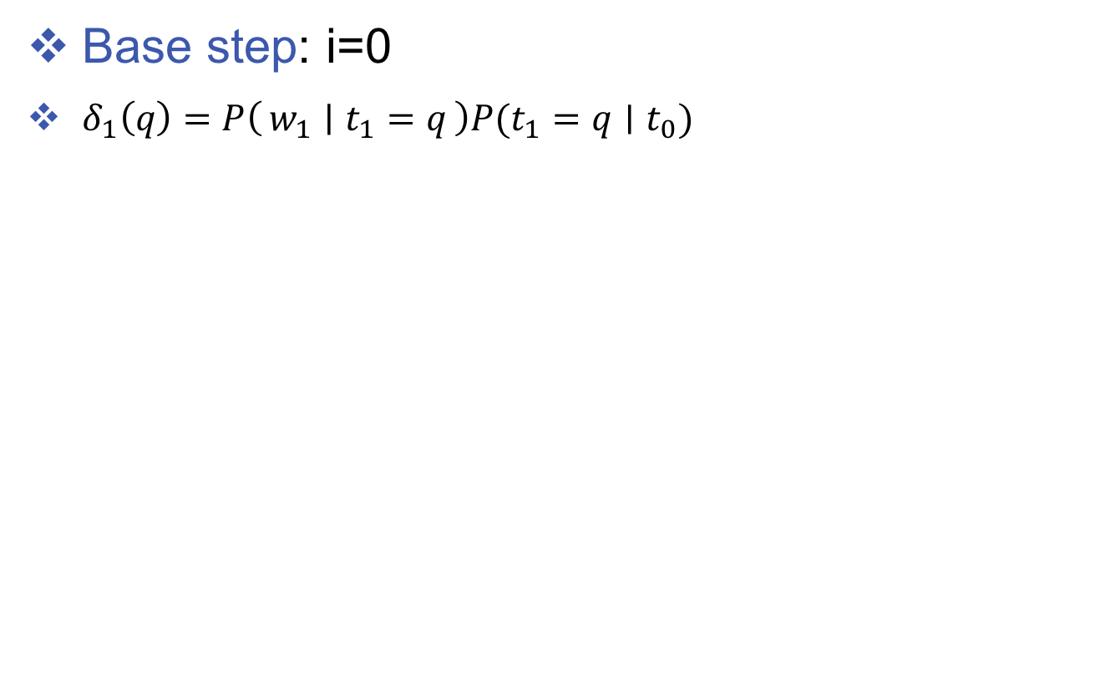
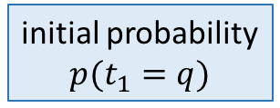
Viterbi algorithm
Base step: i=0
$δ_{1}\left(q\right)=P\left(w_{1} ∣ t_{1}=q\right)P(t_{1}=q∣t_{0})$
initial probability
$$p(t_{1}=q)$$
N
N
N
N
V
V
V
V
$$⋯$$
A
A
A
A
$i=k−1 i=k$

Slide 44
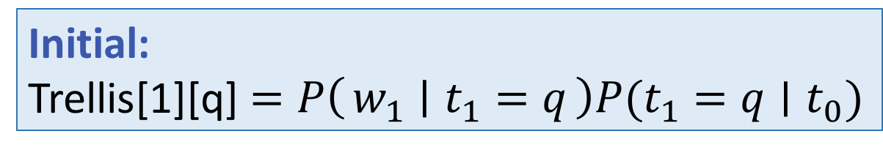
Implementation using an array
Initial:
Trellis[1][q] $=P\left(w_{1} ∣ t_{1}=q\right)P(t_{1}=q∣t_{0})$

Slide 45
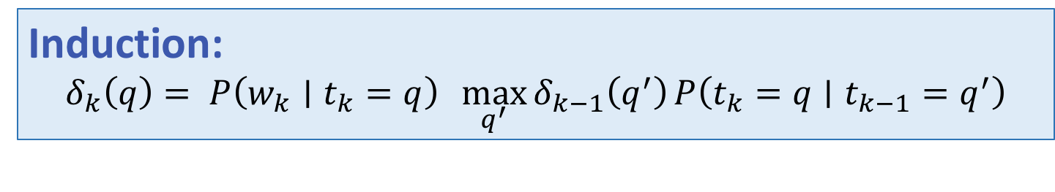
Implementation using an array
Induction:
$$δ_{k}\left(q\right)= P\left({w_{k}∣t}_{k}=q\right){\max_{q^{′}}{δ_{k−1}\left(q^{′}\right)}}P\left({t_{k}=q∣t}_{k−1}=q^{′}\right)$$

Slide 46
Retrieving the best sequence
Keep one backpointer
best

Slide 47
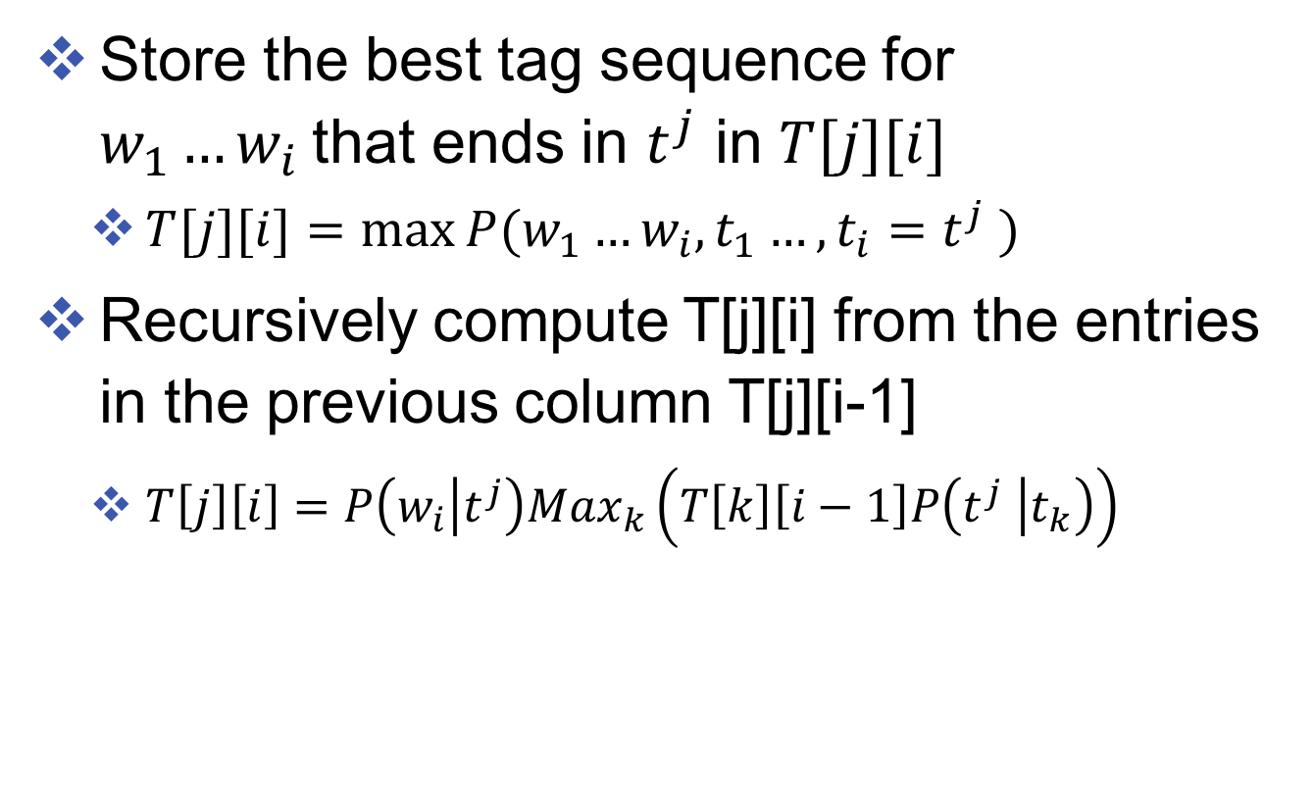
Viterbi algorithm
Store the best tag sequence for $w_{1}…w_{i}$that ends in $t^{j}$ in $T[j][i]$
$T[j][i]=max⁡P(w_{1}…w_{i}, t_{1}…, t_{i}=t^{j} )$
Recursively compute T[j][i] from the entries in the previous column T[j][i-1]
$T\left[j\right]\left[i\right]=P\left(w_{i} | t^{j}\right)Max_{k}\left(T\left[k\right]\left[i−1\right]P\left(t^{j} | t_{k}\right)\right)$
Generating the current observation
Transition from the previous best ending tag
The best i-1 tag sequence
Notes:
update references for RNNs on the course website

Slide 48
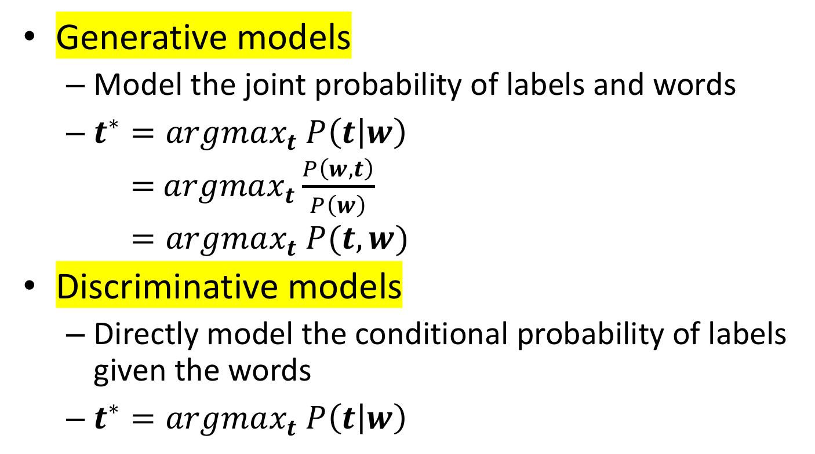
Two modeling perspectives
Generative models
Model the joint probability of labels and words
$t^{∗}=argmax_{t} P\left(t | w\right)$ = $argmax_{t}\frac{P\left(w,t\right)}{P\left(w\right)}$ $=argmax_{t} P(t,w)$
Discriminative models
Directly model the conditional probability of labels given the words
$t^{∗}=argmax_{t} P\left(t | w\right)$
Often modeled by Softmax function

Slide 49
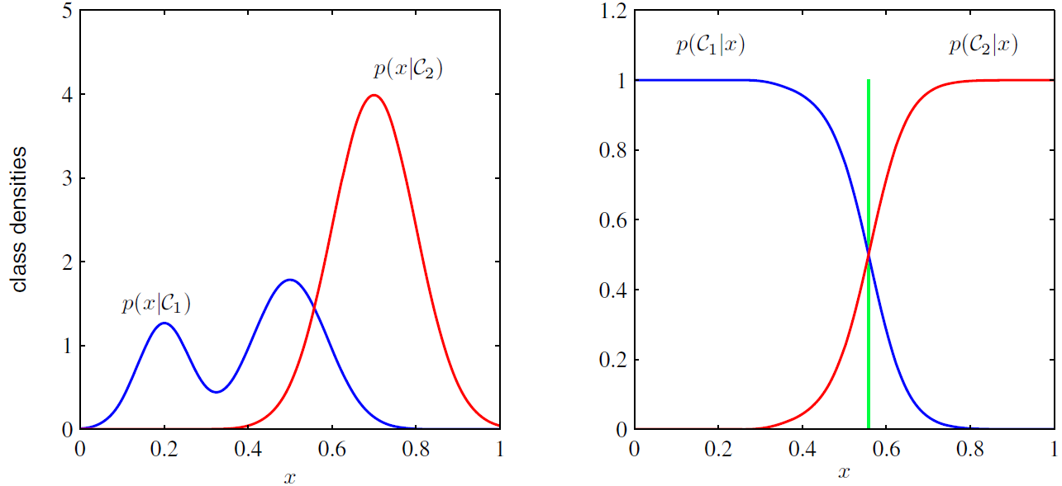
Generative V.S. discriminative models
Binary classification as an example
Generative Model’s view
Discriminative Model’s view

Slide 50
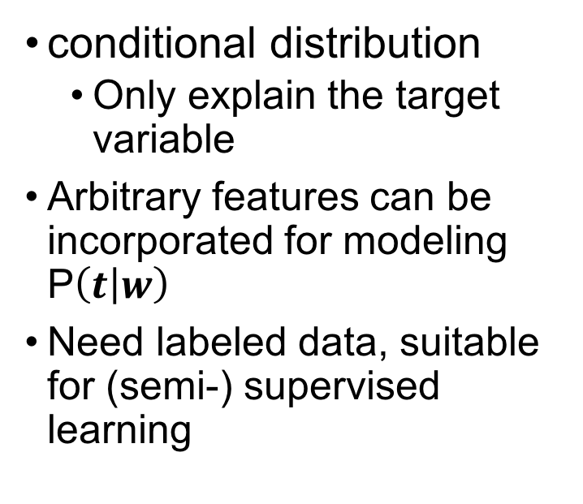
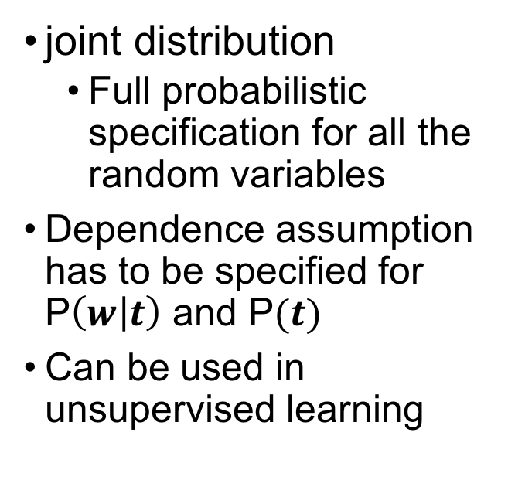
Generative V.S. discriminative models
Generative
Discriminative
joint distribution
Full probabilistic specification for all the random variables
Dependence assumption has to be specified for P$\left(w | t\right)$ and P$(t)$
Can be used in unsupervised learning
conditional distribution
Only explain the target variable
Arbitrary features can be incorporated for modeling P$\left(t | w\right)$
Need labeled data, suitable for (semi-) supervised learning

Slide 51

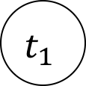

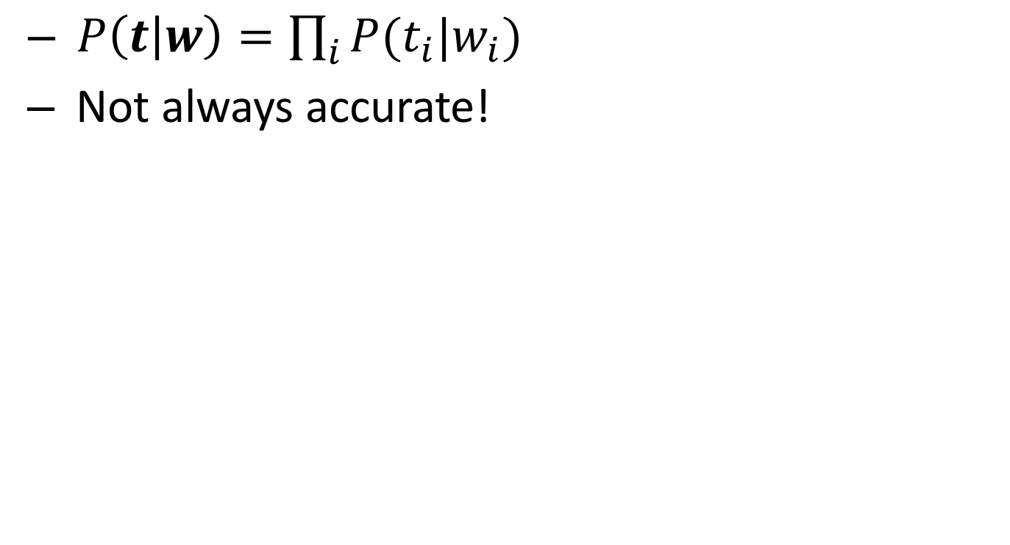
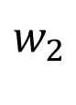
Independent Classifiers
$P\left(t | w\right)=\prod_{i}{P(t_{i}|w_{i})}$
Not always accurate!
$$t_{1}$$
$$t_{2}$$
$$t_{3}$$
$$t_{4}$$
$$w_{1}$$
$$w_{2}$$
$$w_{3}$$
$$w_{4}$$

Slide 52
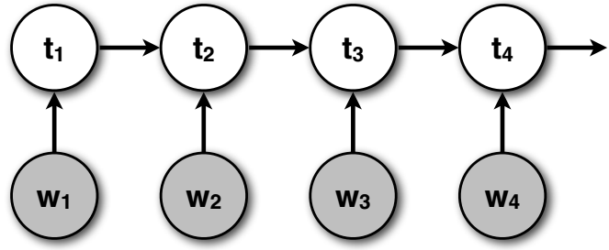
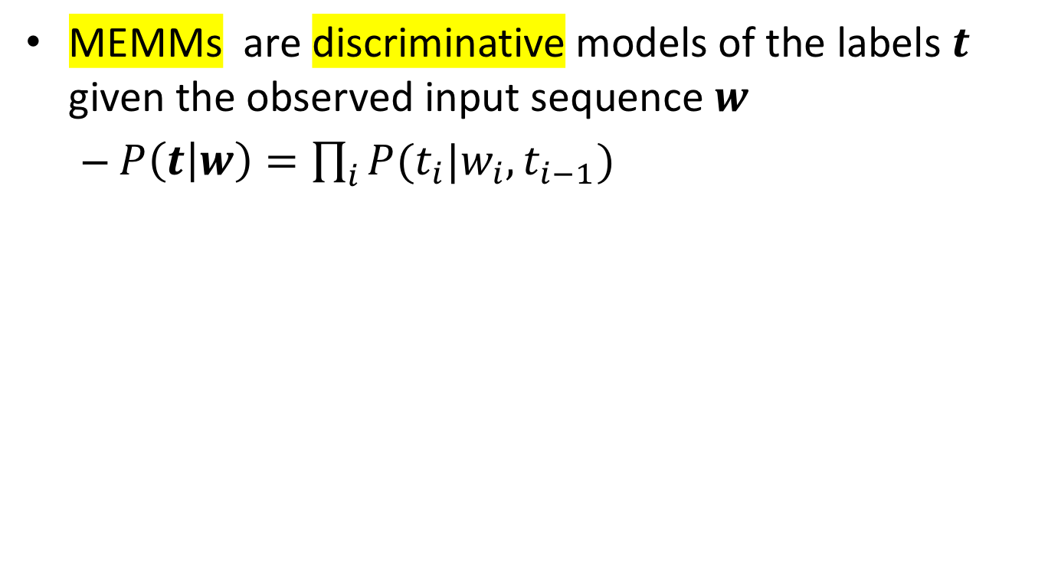
Maximum entropy Markov models
MEMMs are discriminative models of the labels $t$ given the observed input sequence $w$
$P\left(t | w\right)=\prod_{i}{P(t_{i}|w_{i},t_{i−1})}$

Slide 53
Design features
VB
NNP
Emission-like features
Binary feature functions
f_{first-letter-capitalized-NNP}(China) = 1
f_{first-letter-capitalized-VB}(know) = 0
Integer (or real-valued) feature functions
f_{number-of-vowels-NNP}(China) = 2
Transition-like features
Binary feature functions
ffirst-letter-capitalized-VB-NNP(China) = 1
know
China
Not necessarily independent features!

Slide 54
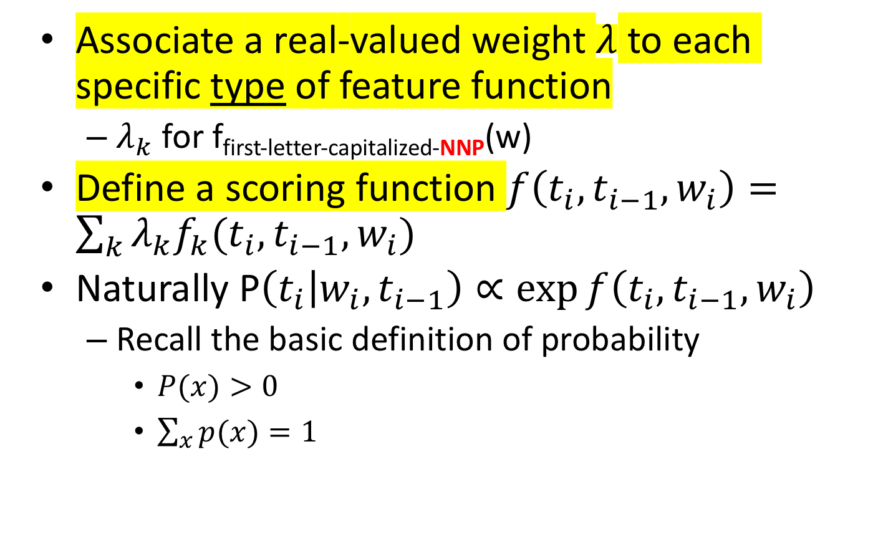

Parameterization of P$(t_{i}|w_{i},t_{i−1})$
Associate a real-valued weight $λ$ to each specific type of feature function
$λ_{k}$ for f_{first-letter-capitalized-NNP}(w)
Define a scoring function $f\left(t_{i},t_{i−1},w_{i}\right)=\sum_{k}{λ_{k}f_{k}({t_{i},t_{i−1},w}_{i})}$
Naturally P$\left(t_{i} | w_{i},t_{i−1}\right)∝\exp{f\left(t_{i},t_{i−1},w_{i}\right)}$
Recall the basic definition of probability
$P(x)>0$
$\sum_{x}{p(x)}=1$

Slide 55
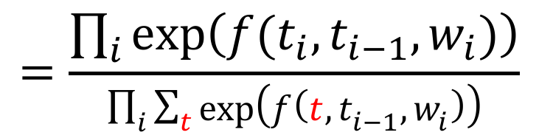
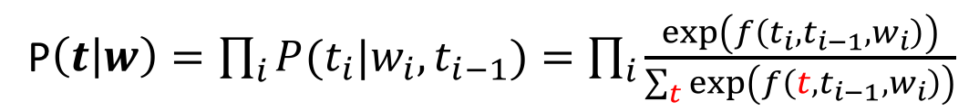
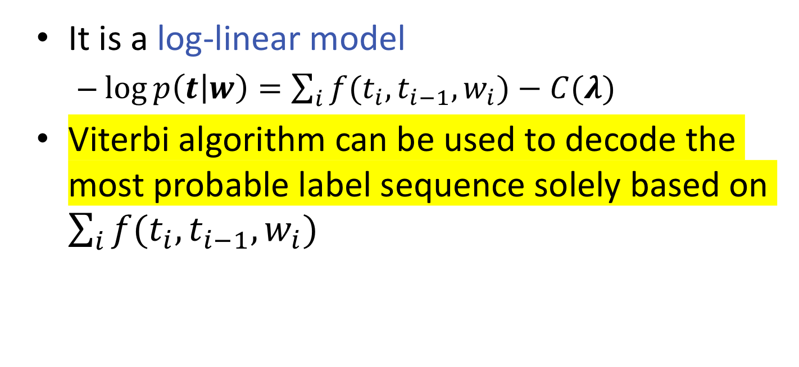
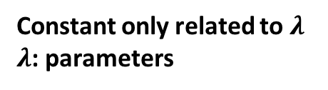
Parameterization of MEMMs
P$\left(t | w\right)=\prod_{i}{P(t_{i}|w_{i},t_{i−1})}=\prod_{i}{\frac{\exp\left(f\left(t_{i},t_{i−1},w_{i}\right)\right)}{\sum_{t}{\exp\left(f\left(t,t_{i−1},w_{i}\right)\right)}}}$
$$=\frac{\prod_{i}{\exp\left(f(t_{i},t_{i−1},w_{i})\right)}}{\prod_{i}{\sum_{t}{\exp\left(f\left(t,t_{i−1},w_{i}\right)\right)}}}$$
It is a log-linear model
$\log{p\left(t | w\right)}=\sum_{i}{f(t_{i},t_{i−1},w_{i})}−C(λ)$
Viterbi algorithm can be used to decode the most probable label sequence solely based on $\sum_{i}{f(t_{i},t_{i−1},w_{i})}$
Constant only related to $λ$
$λ$: parameters

Slide 56


Parameter estimation (Intuition)
Maximum likelihood estimator can be used in a similar way as in HMMs
$λ^{∗}=argmax_{λ}\sum_{t,w}{\log{P(t|w)}}$
$=argmax_{λ}\sum_{t,w}{\sum_{i}{f(t_{i},t_{i−1},w_{i})}−C(λ) }$
Decompose the training data into such units

Slide 57
Parameter estimation (Intuition)
Essentially, training local classifiers using previous assigned tags as features

Slide 58

More about MEMMs
Emission features can go across multiple observations
$f\left(t_{i},t_{i−1},w_{i}\right)≜\sum_{k}{λ_{k}f_{k}(t_{i},t_{i−1},w)}$
Especially useful for shallow parsing and NER tasks

Slide 59
Label biased problem
Consider the following tag sequences as the training data Thomas/B-PER Jefferson/I-PER Thomas/B-LOC Hall/I-LOC
B-PER
E-PER
other
B-LOC
E-LOC

Slide 60
Label biased problem
Thomas/B-PER Jefferson/I-PER Thomas/B-LOC Hall/I-LOC
MEMM:
P(B-PER|Thomas,other)= ½
P(B-LOC|Thomas,other)= ½
P(I-PER|Jefferson, B-PER)=1
P(I-LOC|Jefferson, B-LOC)=1
Should globally normalize!
B-PER
E-PER
other
B-LOC
E-LOC

Slide 61









Conditional Random Field
Model global dependency
P$\left(t | w\right)∝\exp\left(S\left(t,w\right)\right)$ $=\exp{S\left(t,w\right)}/\sum_{t′}{exp}S(t^{′},w)$
Score entire sequence directly
$$t_{1}$$
$$t_{2}$$
$$t_{3}$$
$$t_{4}$$
$$w_{1}$$
$$w_{2}$$
$$w_{3}$$
$$w_{4}$$

Slide 62
Tagging the input
Assume we have 2 tags N, V
Which one is the best?
$P\left(“I love cat”,”NNN” ∣ λ\right), P\left(“I love cat”,”NNV” ∣ λ\right),$ $P\left(“I love cat”,”NVN” ∣ λ\right), P\left(“I love cat”,”NVV” ∣ λ\right),$ $P\left(“I love cat”,”VNN” ∣ λ\right),P\left(“I love cat”,”VNV” ∣ λ\right)$, $P\left(“I love cat”,”VVN” ∣ λ\right),P\left(“I love cat”,”VVV” ∣ λ\right)$
We need an efficient algorithm
Notes:
What’s the complexity for the problem with k possible tags, and n sequence length?

Slide 63



Conditional Random Field
$S\left(t,w\right)=\sum_{i}{(\sum_{k}{{λ_{k}f}_{k}\left(t_{i},w\right)+\sum_{l}{γ_{l}g_{l}(t_{i}, t_{i−1},w)}}}$)
P$\left(t | w\right)∝$ $\exp\left(S\left(t,w\right)\right)$ =$\prod_{i}{\exp{(\sum_{k}{{λ_{k}f}_{k}\left(t_{i},w\right)+\sum_{l}{γ_{l}g_{l}(t_{i}, t_{i−1},w)}})}}$
Edge feature $g(t_{i},t_{i−1},w)$
$$t_{1}$$
$$t_{2}$$
$$t_{3}$$
$$t_{4}$$
Node feature $f(t_{i},w)$
$$w_{1}$$
$$w_{2}$$
$$w_{3}$$
$$w_{4}$$

Slide 64
Design features
VB
NNP
Emission-like features
Binary feature functions
f_{first-letter-capitalized-NNP}(China) = 1
f_{first-letter-capitalized-VB}(know) = 0
Integer (or real-valued) feature functions
f_{number-of-vowels-NNP}(China) = 2
Transition-like features
Binary feature functions
ffirst-letter-capitalized-VB-NNP(China) = 1
know
China
Not necessarily independent features!

Slide 65

General Idea
We want the score to the correct answer $S\left(t^{∗},w\right)$ higher than others. $S\left(t^{∗},w\right)>S\left(t^{′},w\right) ∀t^{′}∈T, t^{′}≠t^{∗}$
Different level of mistakes $S\left(t^{∗},w\right)≥S\left(t^{′},w\right)+Δ(t^{′},t^{∗}) ∀t^{′}∈T$
Several ML models can be used
Structured Perceptron
Structured SVM
Learning to Search

Slide 66

Log-linear model
P$\left(t | w\right)∝$ $\exp\left(S\left(t,w\right)\right)$
$S\left(t,w\right)=\sum_{i}{(\sum_{k}{{λ_{k}f}_{k}\left(t_{i},w\right)+\sum_{l}{γg_{l}(t_{i}, t_{i−1},w)}}}$)
$=\sum_{k}{λ_{k}(\sum_{i}{f_{k}\left(t_{i},w\right))}}+\sum_{l}{γ_{l}(\sum_{i}{g_{l}(t_{i}, t_{i−1},w))}}$
$\left[\begin{aligned}\begin{matrix}λ_{1} \\ λ_{2} \\ ⋮\end{matrix} \\ γ_{1} \\ γ_{2} \\ ⋮\end{aligned}\right]⋅\left[\begin{aligned}\begin{matrix}\sum_{i}{f_{1}\left(t_{i},w\right))} \\ \sum_{i}{f_{2}\left(t_{i},w\right))} \\ ⋮\end{matrix} \\ \sum_{i}{g_{1}(t_{i}, t_{i−1},w))} \\ \sum_{i}{g_{2}(t_{i}, t_{i−1},w))} \\ ⋮\end{aligned}\right]$
Essentially, we aggregate transition and emission patterns as features
$$θ ⋅ F(t,w)$$

Slide 67

MEMM v.s. CRF
Like in the previous slide, we can rearrange the summations
Score function can be the same: $S\left(t,w\right)=\sum_{i}{(\sum_{k}{{λ_{k}f}_{k}\left(t_{i},w\right)+\sum_{l}{γg_{l}(t_{i}, t_{i−1},w)}}}\text{)}$ $=\sum_{i}{f(t_{i},t_{i−1},w_{i})}$
MEMM:
$P\left(t | w\right)=\prod_{i}{P\left(t_{i} | w_{i},t_{i−1}\right)}=\frac{\prod_{i}{\exp\left(f(t_{i},t_{i−1},w_{i})\right)}}{\prod_{i}{\sum_{t}{\exp\left(f\left(t,t_{i−1},w_{i}\right)\right)}}}$
CRF:
$P\left(t | w\right)=\frac{exp (S\left(t,w\right)) }{\sum_{t}{\exp\left(S\left(t,w\right)\right)}}=\frac{\prod_{i}{\exp\left(f(t_{i},t_{i−1},w_{i})\right)}}{\sum_{t}{\prod_{i}{\exp\left(f(t_{i},t_{i−1},w_{i})\right)}}}$
Locally normalized
globally normalized

Slide 68
HMM v.s. MEMM v.s. CRF
P(X,Y)
P(Y|X)

Slide 69

Inference
Find the best scoring output given the model
$\underset{y}{argmax} S \left(y, x \right)$
Output space is usually exponentially large
Inference algorithms:
Specific: e.g., Viterbi (linear chain)
General: Integer linear programming (ILP)
Approximate inference algorithms: e.g., belief propagation, dual decomposition
Notes:
As in the corefernece resolution task, we can to design a scoring function …
For example, in pos, the input , .. Output ..
And the features can be generated from both words and tags. For example, we know a verb is usually followed by a noun phrase rather than another verb, So we can design this as a feature. Then system will learn a model form the data to assign this higher weight to verb-determent and lower weight to verb-verb pair.

Slide 70
Learning Structured Models
Solve inferences
Update the model
(stochastic) gradient updates

Slide 71

Example: Structured Perceptron
Goal: we want the score to the correct answer $S\left(y^{∗},x;θ\right)$ higher than others. $S\left(y^{∗},x;θ\right)>S\left(y^{′},x;θ\right) ∀y^{′}∈T, y^{′}≠y^{∗}$
Let $S\left(y,x;θ\right)=θ⋅F(y,x;θ)$
Give training data $\{{(y}_{i},x_{i})\}, i=1…N$
Loop until converge
For i = 1…N
Let $y^{′}=\arg{\max_{y}{θ⋅F(y,x;θ)}}$
If $y^{′}≠y^{∗}: θ←θ+η(F\left(y^{∗},x;θ\right)−$ $F(y′,x;θ)$)

